Slide 1
The use of wireless devices to support learning in Special Needs Science Lessons.
by Patrick Organ and Barbara Watson
Notes:
Rationale
It is generally agreed that the more actively involved a pupil is in their learning, the more likely they are to enjoy it and make progress. Unfortunately, some children are limited in their opportunities to participate due to problems with mobility, co-ordination or their ability to process complex information.

Slide 2
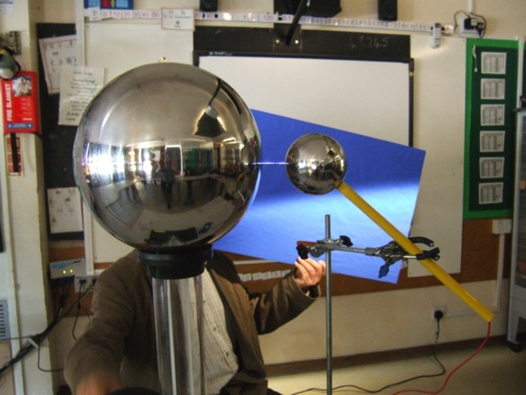
Target the learning
Be imaginative
Have fun
Notes:
Rationale
I’m not providing this information as an advocate for using wireless devices indiscriminately. I feel it is much more important to make your lessons relevant, stimulating and fun.

Slide 3
hardware
games machines
tablets
software
games
science apps
alternatives
imaginative approaches
handheld game machines
making a pc/whiteboard more accessible
other apps
what is worth it
Notes:
The new range of wireless interactive computer-based devices offers a possible solution.
The aim of this project is to explore the various devices available, the software that supports them, and the alternative strategies that can be used.

Slide 4
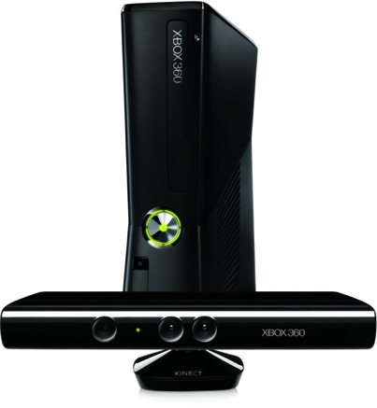
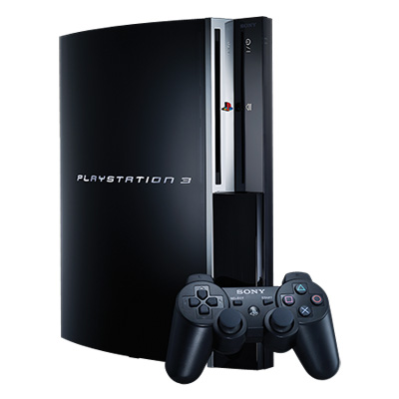
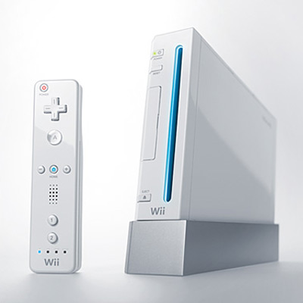
Games Machines
Notes:
The current range of games machines (the so called 7th generation) has continued to be dominated by the three main providers: Sony, Nintendo and Microsoft.

Slide 5
Manufacturer | Device | Remote sensing system | Comments
Sony | PlayStation 3 | Move | One or two controllers Tracked accurately by camera High quality graphics
Nintendo | Wii / Wii + | Wii remote & nunchuck Wii motion + Wii fit balance board | Relatively poor graphics. Accessories – such as steering wheels – can make using remotes easier.
Microsoft | Xbox 360 | Kinect | No remote needed – responds to gestures and spoken commands.
Notes:
The current range of games machines (the so called 7th generation) has continued to be dominated by the three main providers: Sony, Nintendo and Microsoft.
The table below summarises some of their properties:

Slide 6
Manufacturer | Device | Remote sensing system | Comments
Sony | PlayStation 4 | DualShock4 controller with inbuilt touchpad and Light Bar for Move-style motion sensing (PlayStation Camera required, sold separately) | Available now.
Nintendo | Wii U | Tablet device that allows interaction with main screen/uninterrupted play. Wii Remotes. | Available now.
Microsoft | Xbox One | Kinect 2 | Available now.
Notes:
The new range – apart from the wii u we are still guessing.

Slide 7
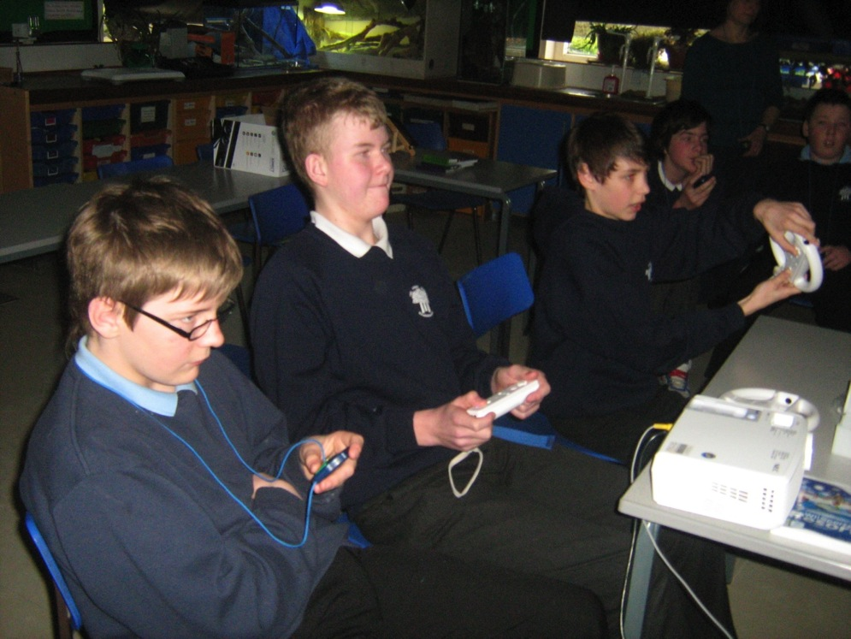
short video clip using wii.mp4

Slide 8
Mario Kart Wii
simple speed comparisons – one player against another.
timing
acceleration and deceleration
friction
Notes:
The Wii was used to support a series of lessons on speed and friction.

Slide 9
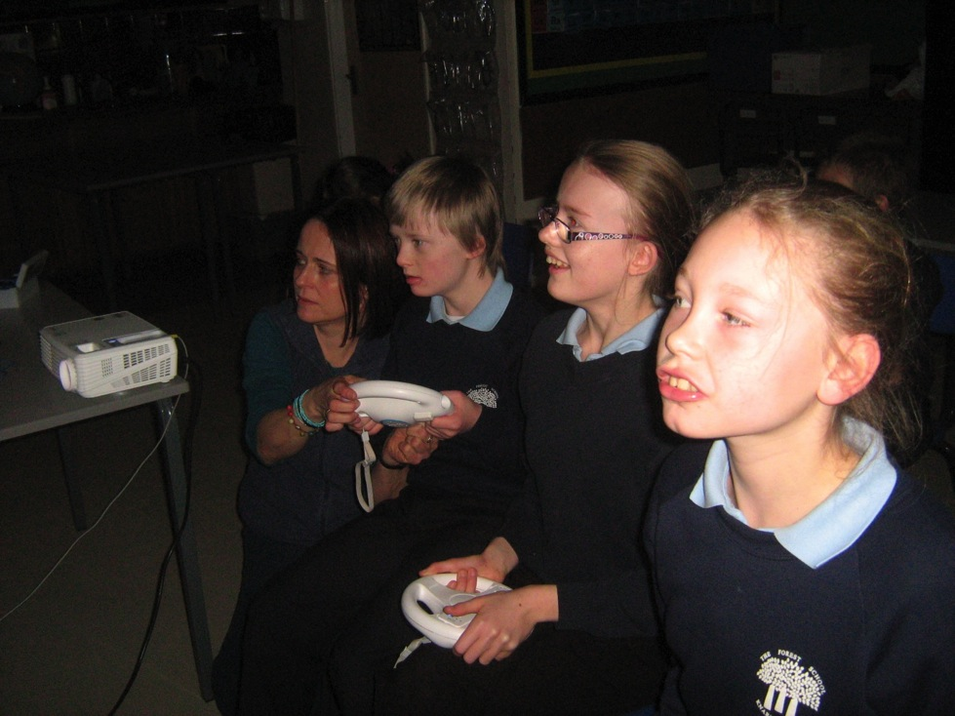
wii clip 2

Slide 10
Mario Kart Wii
difficulties with “A” and “B” buttons.
Problems knowing which vehicle they are.
Difficulties using the steering wheel – eg moving through too large an angle.
Notes:
Some pupils had particular difficulties using the device, but all found it very motivating.

Slide 11
Other Wii activities
Big brain academy
Wii fit
Wii sports and wii sports resort
Wii Lets Dance
Notes:
These are some of the activities I have used successfully with some of the children.

Slide 12
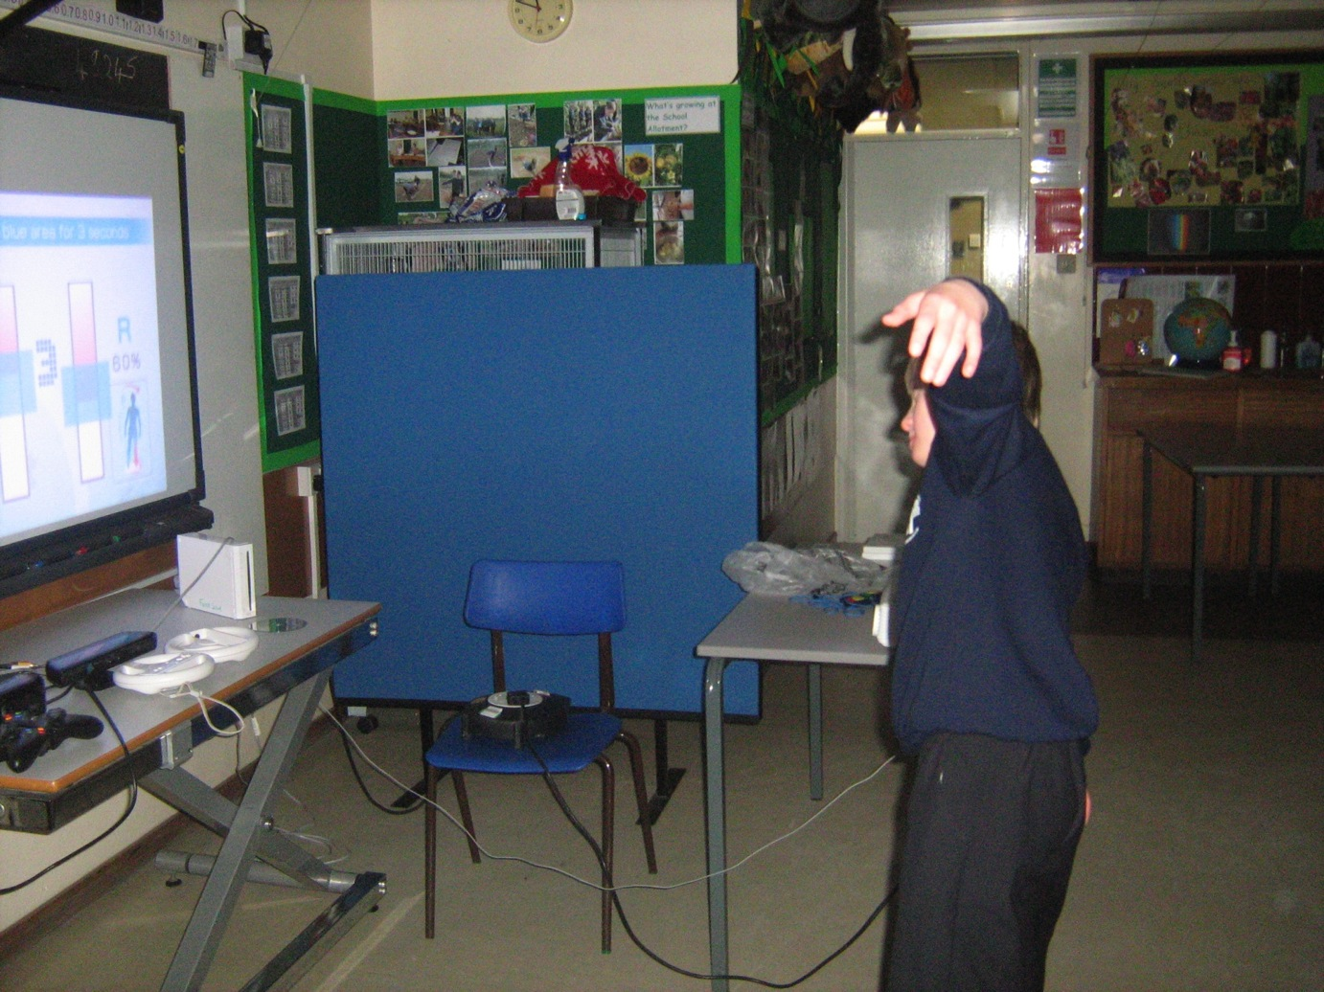
Notes:
Using the wii fit balance board

Slide 13
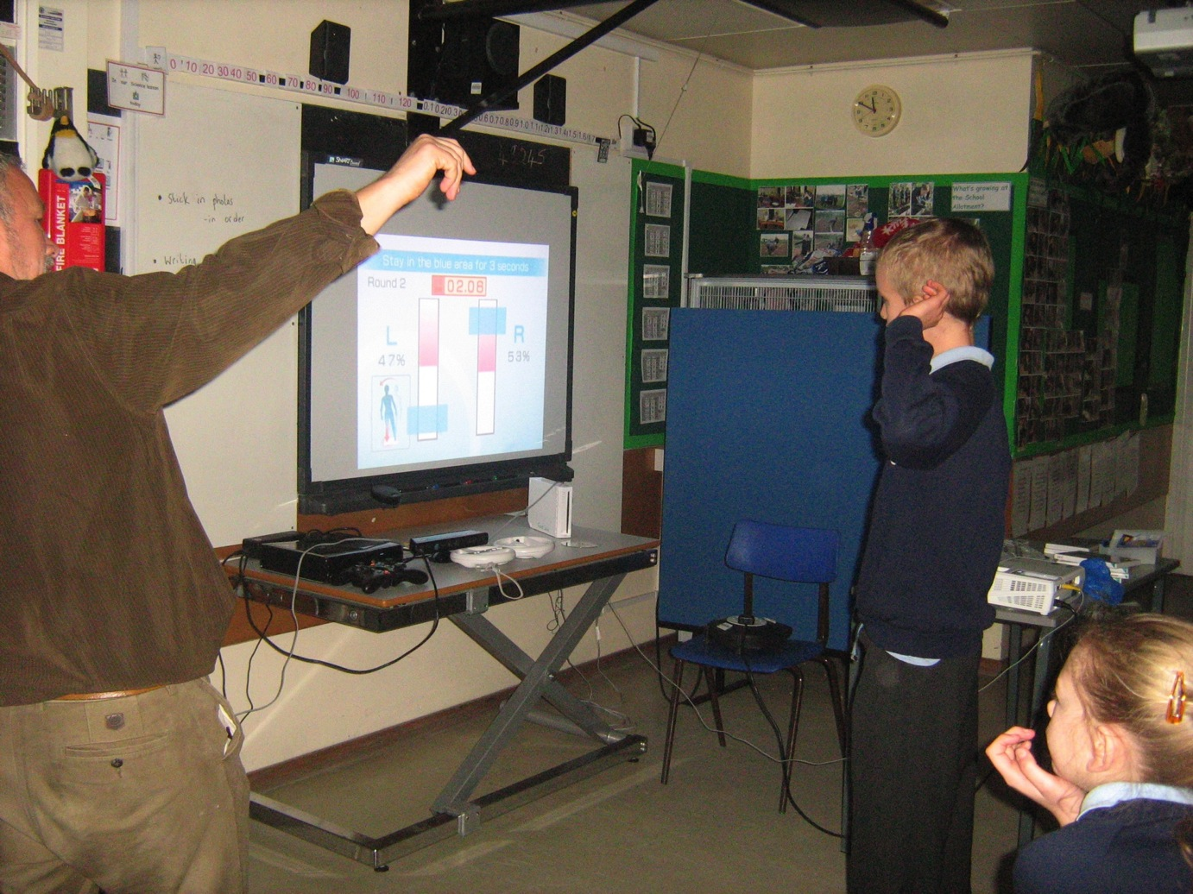

Slide 14
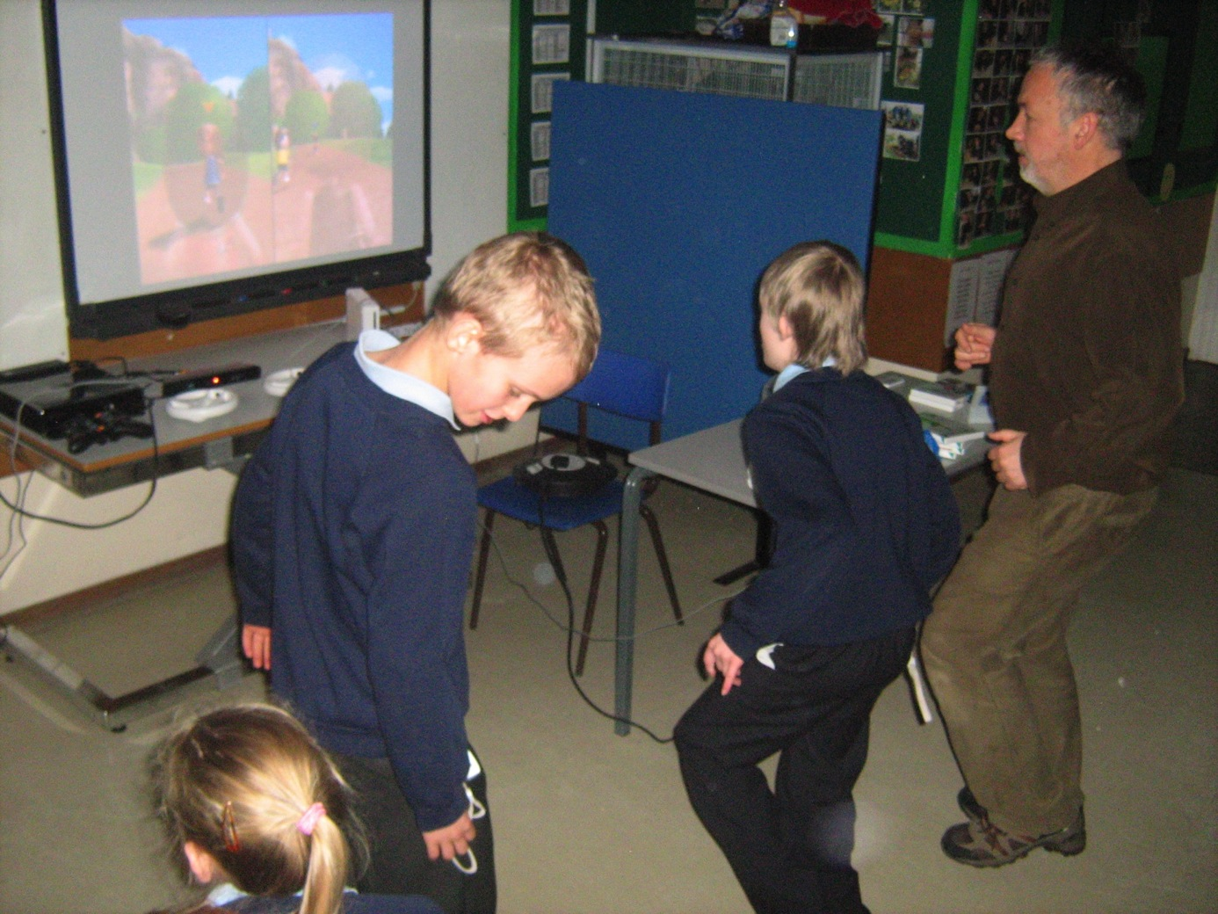

Slide 15
X Box Kinect
No remote needed – system uses an infrared camera and creates an avatar.
Two players can stand next to each other.
Pupils can change the look of their avatars.
Notes:
The kinect gets over many of the problems associated with hand held devices.

Slide 16
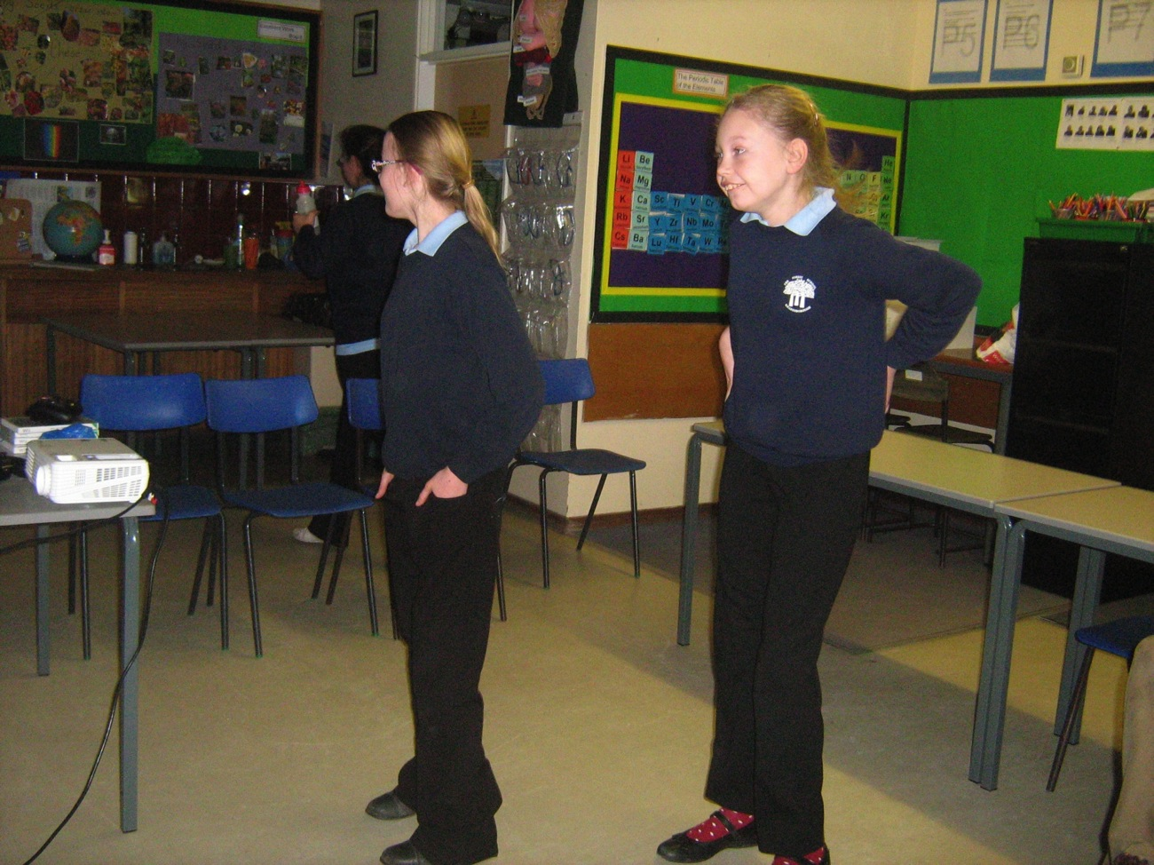
Notes:
Using the xbox and kinect allows the pupils to interact in a much more meaningful way.

Slide 17
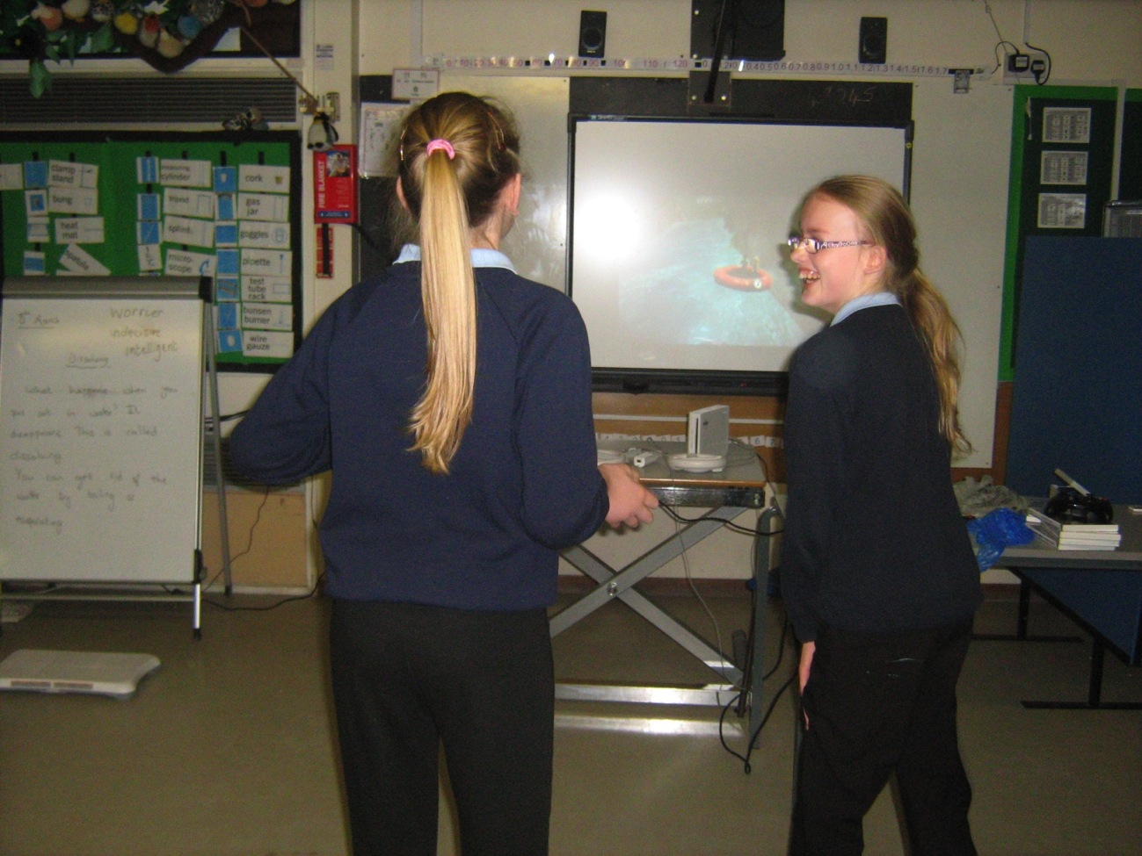

Slide 18
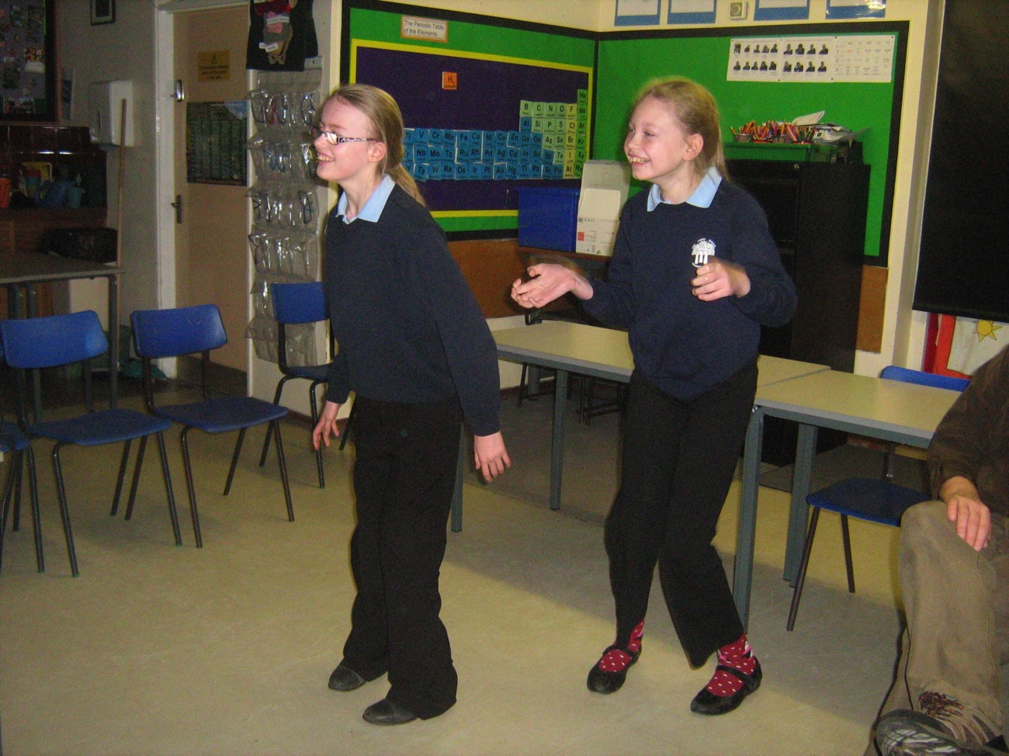

Slide 19
X Box Kinect Activities
Kinect Adventures
Kinect Zumba fitness
Sesame Street
Kinect fun labs – air band, kinect me, googly eyes connect to fun lab website
Body and Brain connection
Notes:
Kinect adventures – a lot of movement games – the rapids one is probably the best for getting some science out of it.
Zumba fitness was used with a PE class
Sesame street uses the camera to put you into the programme – it has to be used online
Kinect fun labs – again you need to be online – air band is particularly fun.
Body and brain connection – dr kawashima updated.

Slide 20
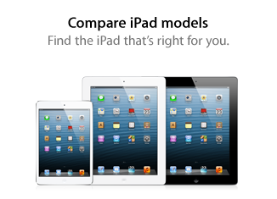
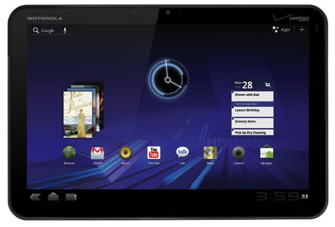
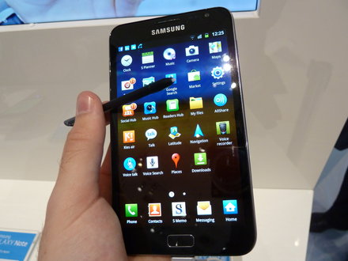
Tablets

Slide 21
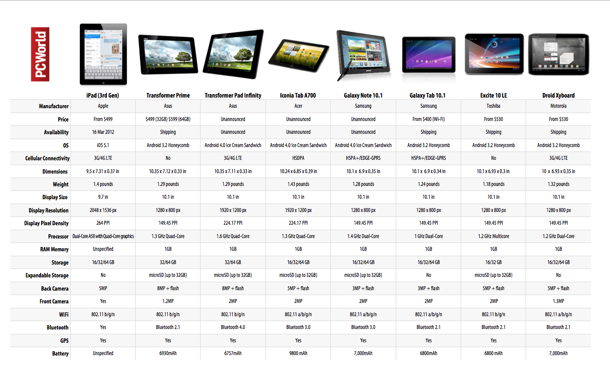
Notes:
not mentioned – Amazon’s kindle fire – by far the cheapest.

Slide 22
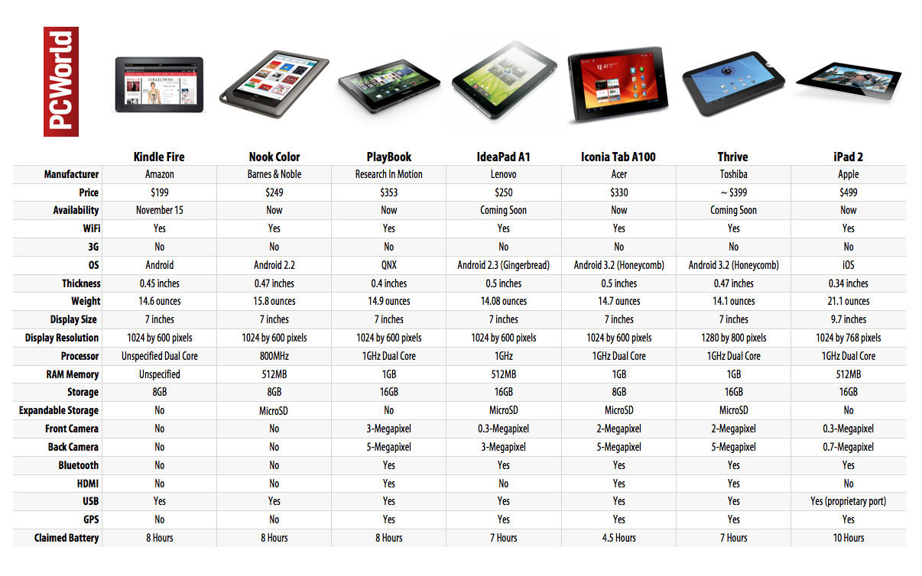
Notes:
more up to date list

Slide 23
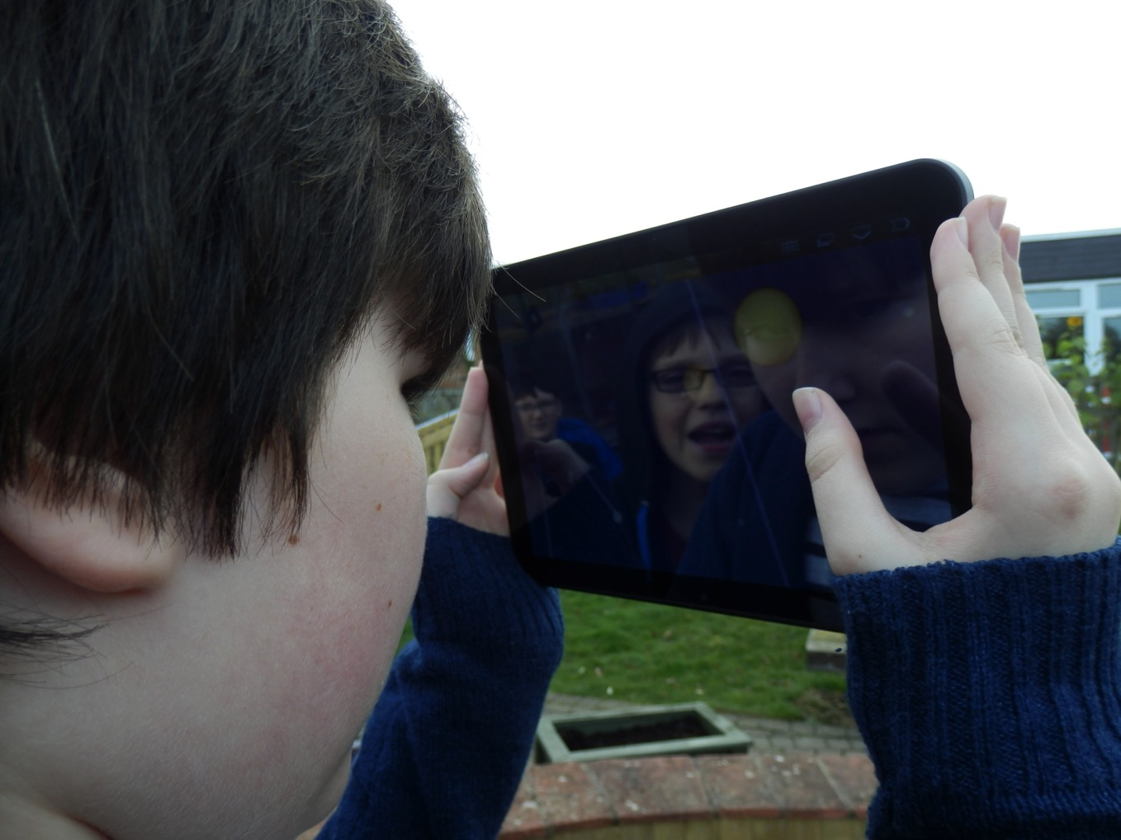
Notes:
Using a xoom with Google Sky Maps in a lesson asking “where does the Sun go at night?”

Slide 24
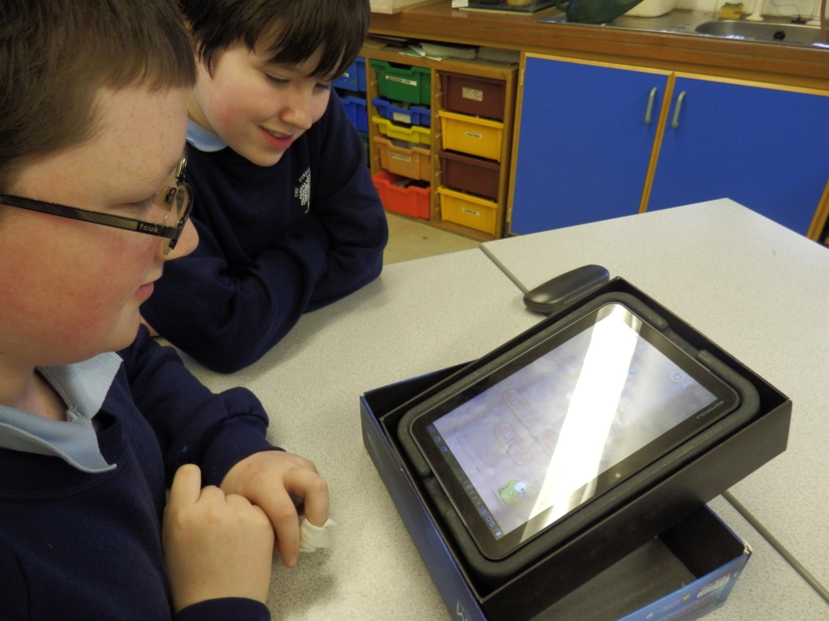

Slide 25
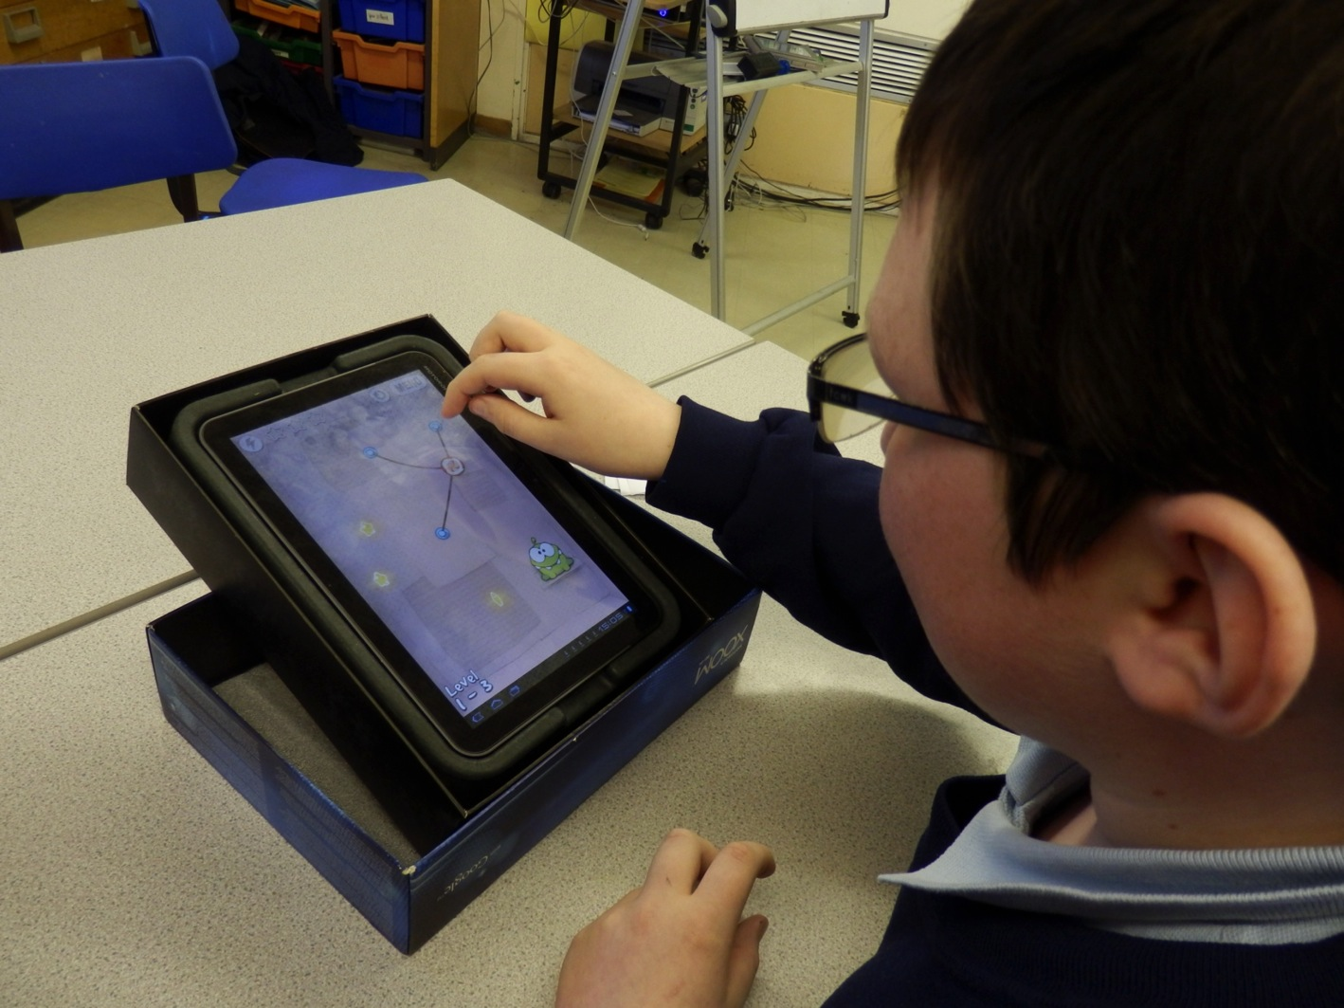

Slide 26
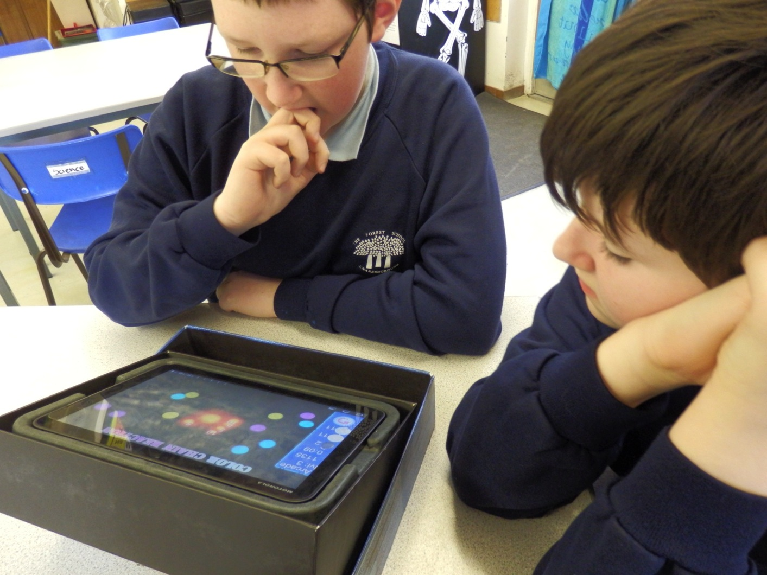

Slide 27
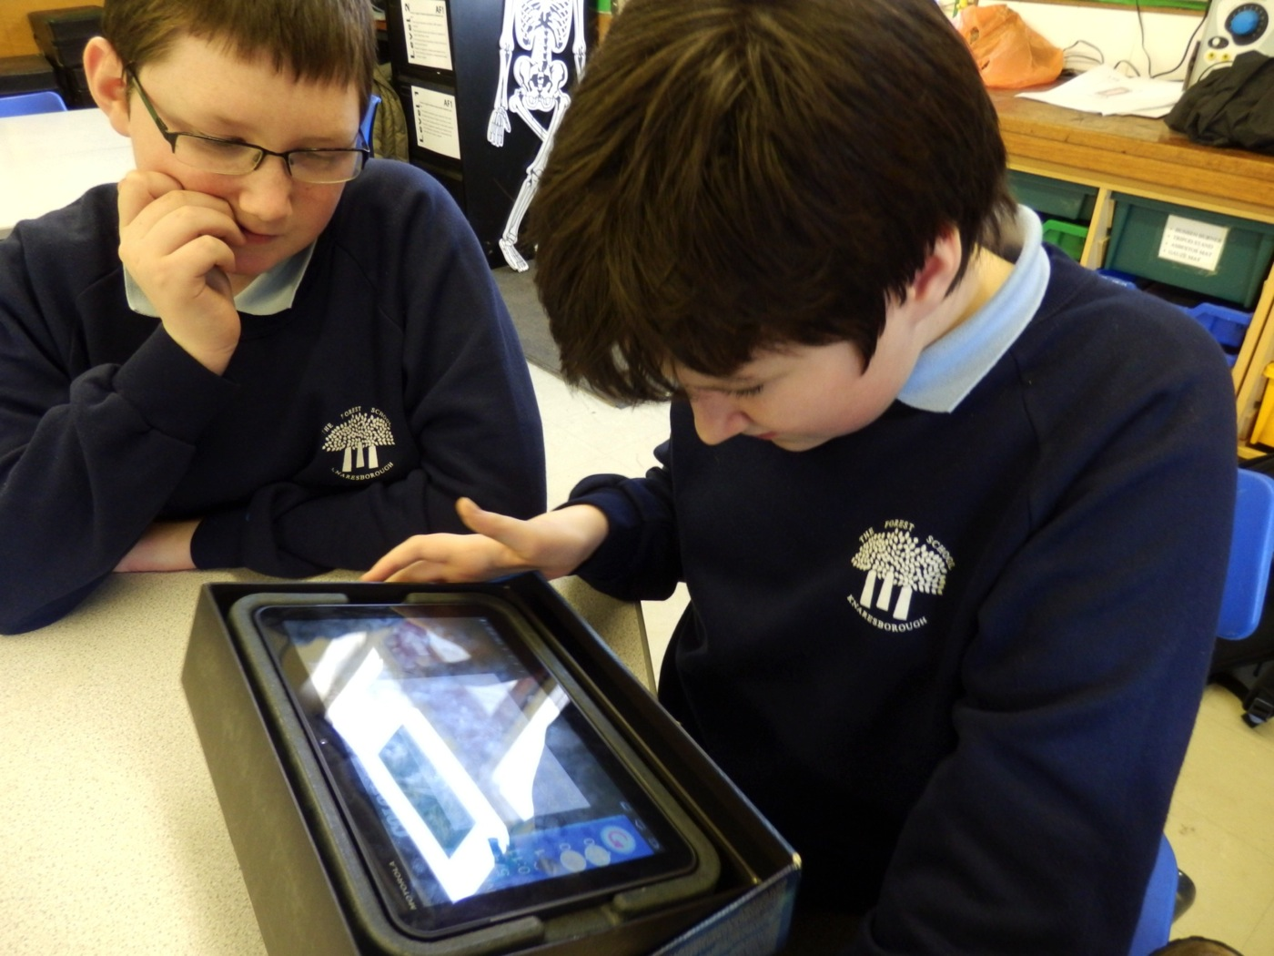

Slide 28
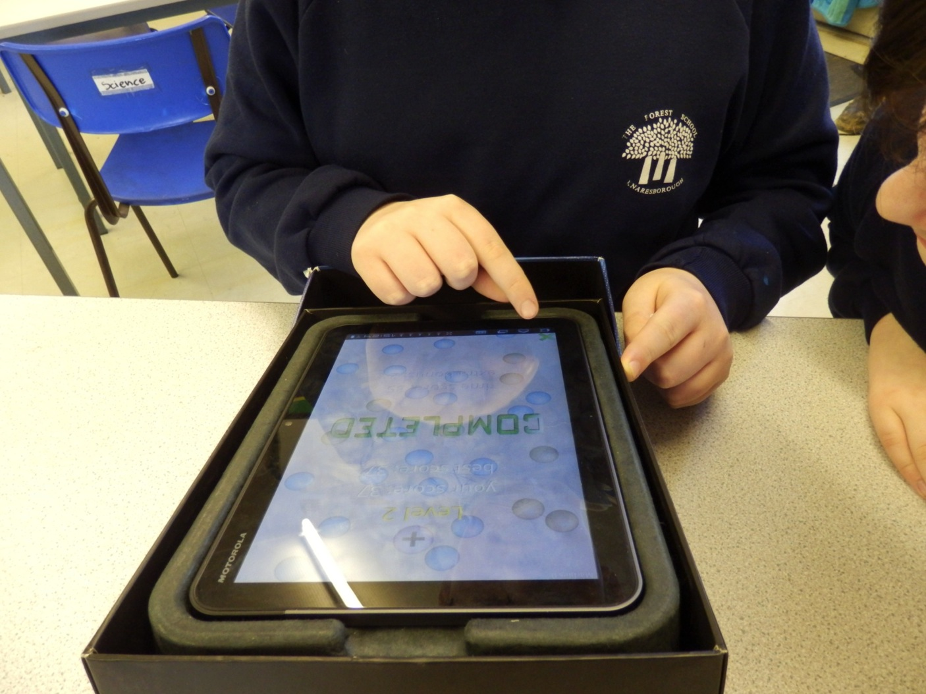

Slide 29
Motorola Xoom
voice recognition
position and movement sensors
front and back cameras
uses android 3 – most apps are mobile phone apps.
short clip using the xoom

Slide 30
Xoom Apps
talking tom
sound effects/ sound touch
youth musical instruments
cut the rope
cyclone frenzy
colour chain reaction
for science
marble rain

Slide 31
ipad Apps
10 top science ipad apps
adobe ideas – photo annotation app

Slide 32
PC with wireless mouse
no need for new software
allows pupils to “join in”
makes using pc easier for everyone.

Slide 33
PC with wireless mouse
science games

Slide 34
What is worth it
wireless mouse and keyboard
a tablet of some description – there are lots of free apps to choose from
xbox 360 kinect – especially if you have a wireless internet connection

Slide 35
Where next?
http://dailyedventures.com/index.php/2012/09/20/shannon/
http://www.microsoft.com/education/en-us/products/Pages/kinect.aspx
http://kinectsen.wikispaces.com/
http://www.special-needs-kids.co.uk/Special-Needs-Software.htm
http://blog.learningtoday.com/blog/bid/24286/Wii-Therapy-for-Special-Needs-Students

